Slide 1

StokBox: Group 24
CW5: Presentation

Slide 2
Table of contents
1
Overview of the project
George Rogers
2
Project software architecture
David Igandan
3
A demonstration of key/interesting features
Tharidhu Angodage
4
Software design decisions
Jack Trafford
5
Something non-technical that you learnt
Darren Wu
6
Group Communication
Suraj Cheema
7
Social/Legal/Ethical Issues
Hemal Patel
8
Realistic plans to take this project onwards
Raihaan Azam

Slide 3
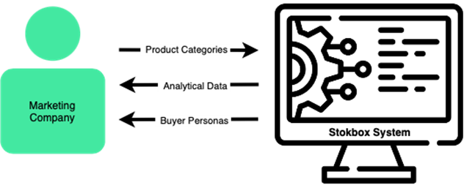

Overview of the Stokbox Analytics Project
1
Overview of the project
George Rogers
The main purpose of this project is to generate buyer personas for marketing companies
Also, the webapp can display statistics and visuals to the user

Slide 4
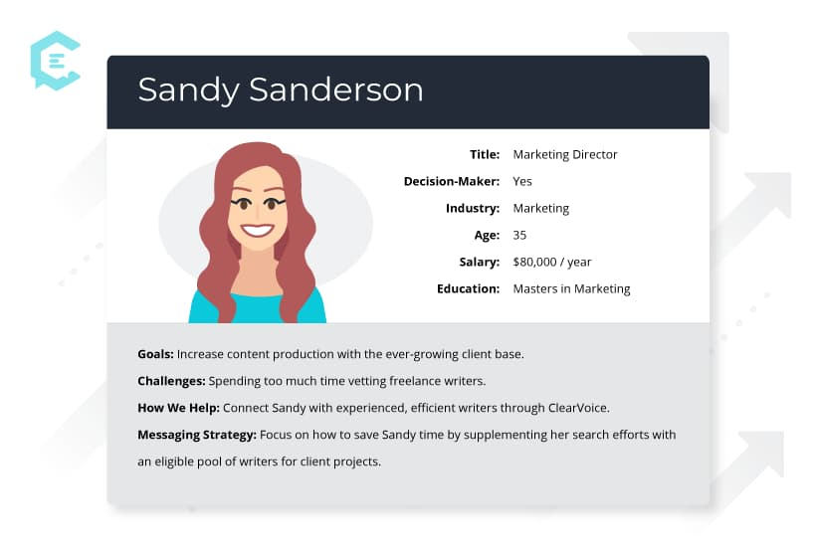
What is a Persona?
1
Overview of the project
George Rogers
A buyer persona is a fictional visualization of a company's ideal customer based off a data set
This allows large data to be condensed down into smaller easy to view representations of a target audience
A company can then use this to discover where in the audience to target

Slide 5
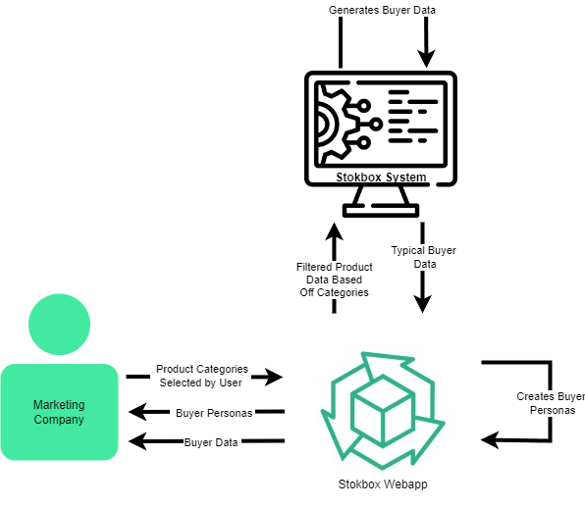
Detailed Diagram of the System
1
Overview of the project
George Rogers

Slide 6
Overview of the Stokbox Analytics Project
1
Overview of the project
George Rogers
The end goal of StokBox is to allow small businesses to gain an insight of where/what areas they should target when marketing their company
This will allow them to market more effectively saving costs and increasing profits for the business

Slide 7
Project Software Architecture
2
Project software architecture
David Igandan
Built using the following technologies
Laravel - an MVC framework
Provided separation of concerns
Eloquent ORM- easier than SQL queries
Provides useful services: authentication, notifications and the templating engine
Includes templating engine
MySQL – Relational Database
Bootstrap 5 – UI framework

Slide 8
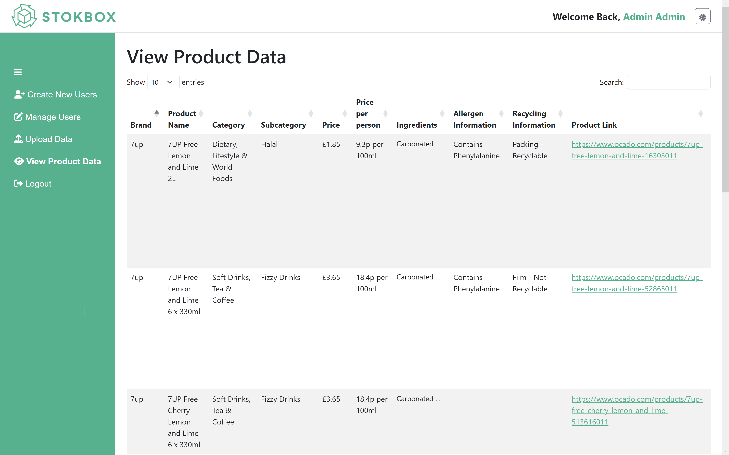
2
Project software architecture
David Igandan

Slide 9
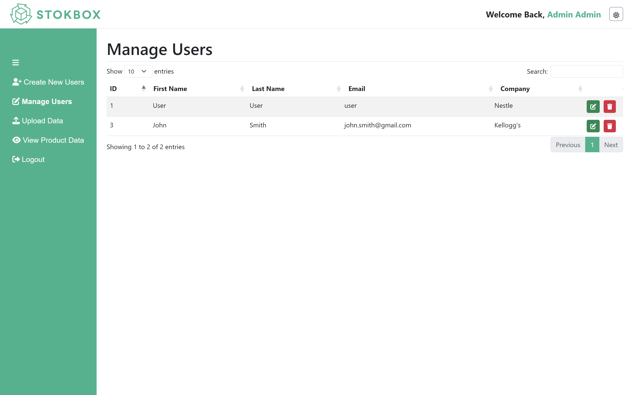
2
Project software architecture
David Igandan

Slide 10
Disadvantages of Laravel
2
Project software architecture
David Igandan
Difficult learning curve - few members knew PHP
No use of university computer
Django may have been a better alternative
Python Language fluency in the group
AI and Data analytics libraries
Python has better libraries for data analytics and AI applications than PHP

Slide 11
Key and Interesting Features
3
A demonstration of key/interesting features
Tharidhu Angodage
Dashboard Filtering System
Offers various graphs that are easy to understand.
Provide the user with a highly customizable experience by allowing them to filter the data by Age, Gender, City, Income, Number of Dependents and Dietary Requirements.
Brand Page Filtering System
Allows brand ambassadors to choose the product categories they are interested in.
The dashboard is automatically filtered according to the brand’s interested product categories.

Slide 12
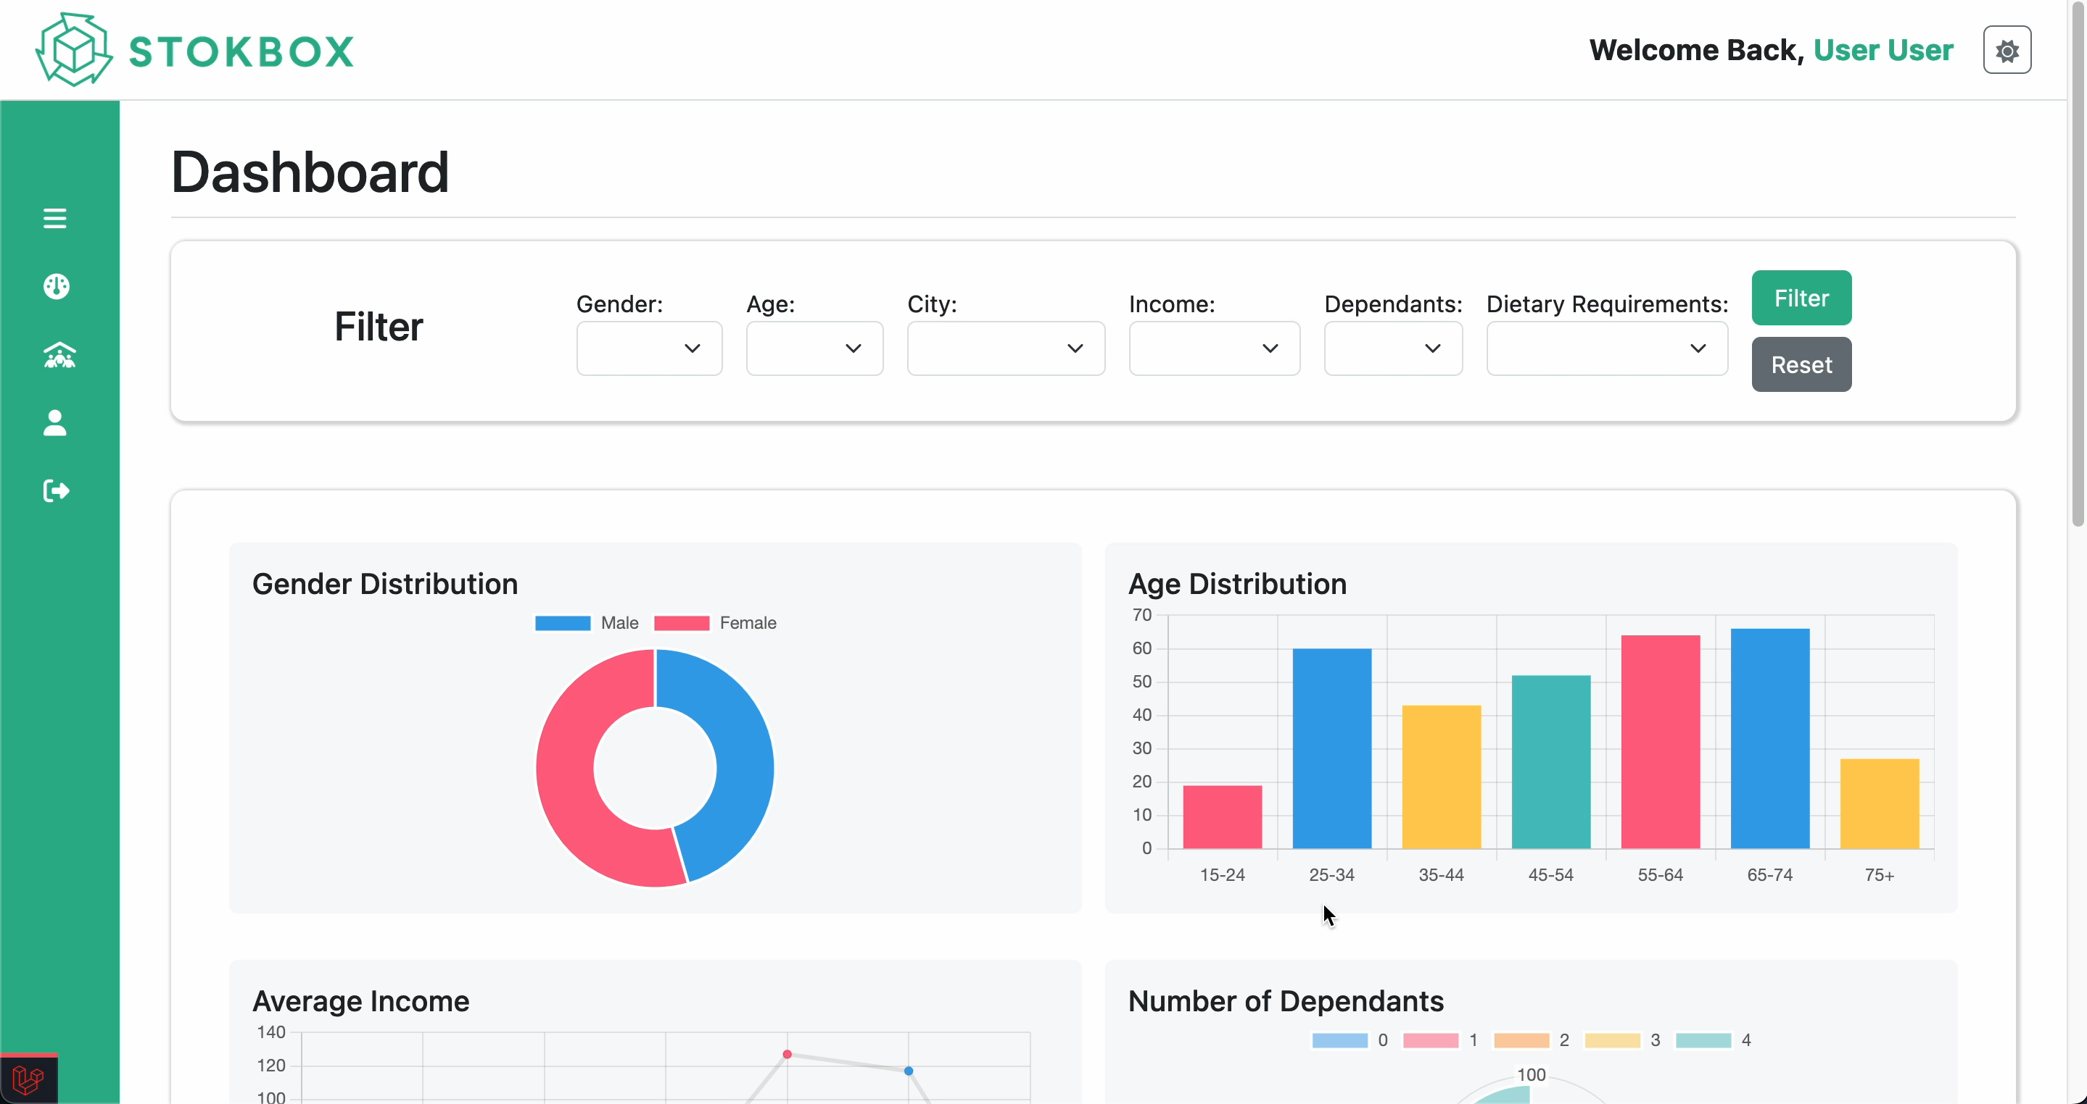
Dashboard Filtering System
3
A demonstration of key/interesting features
Tharidhu Angodage

Slide 13
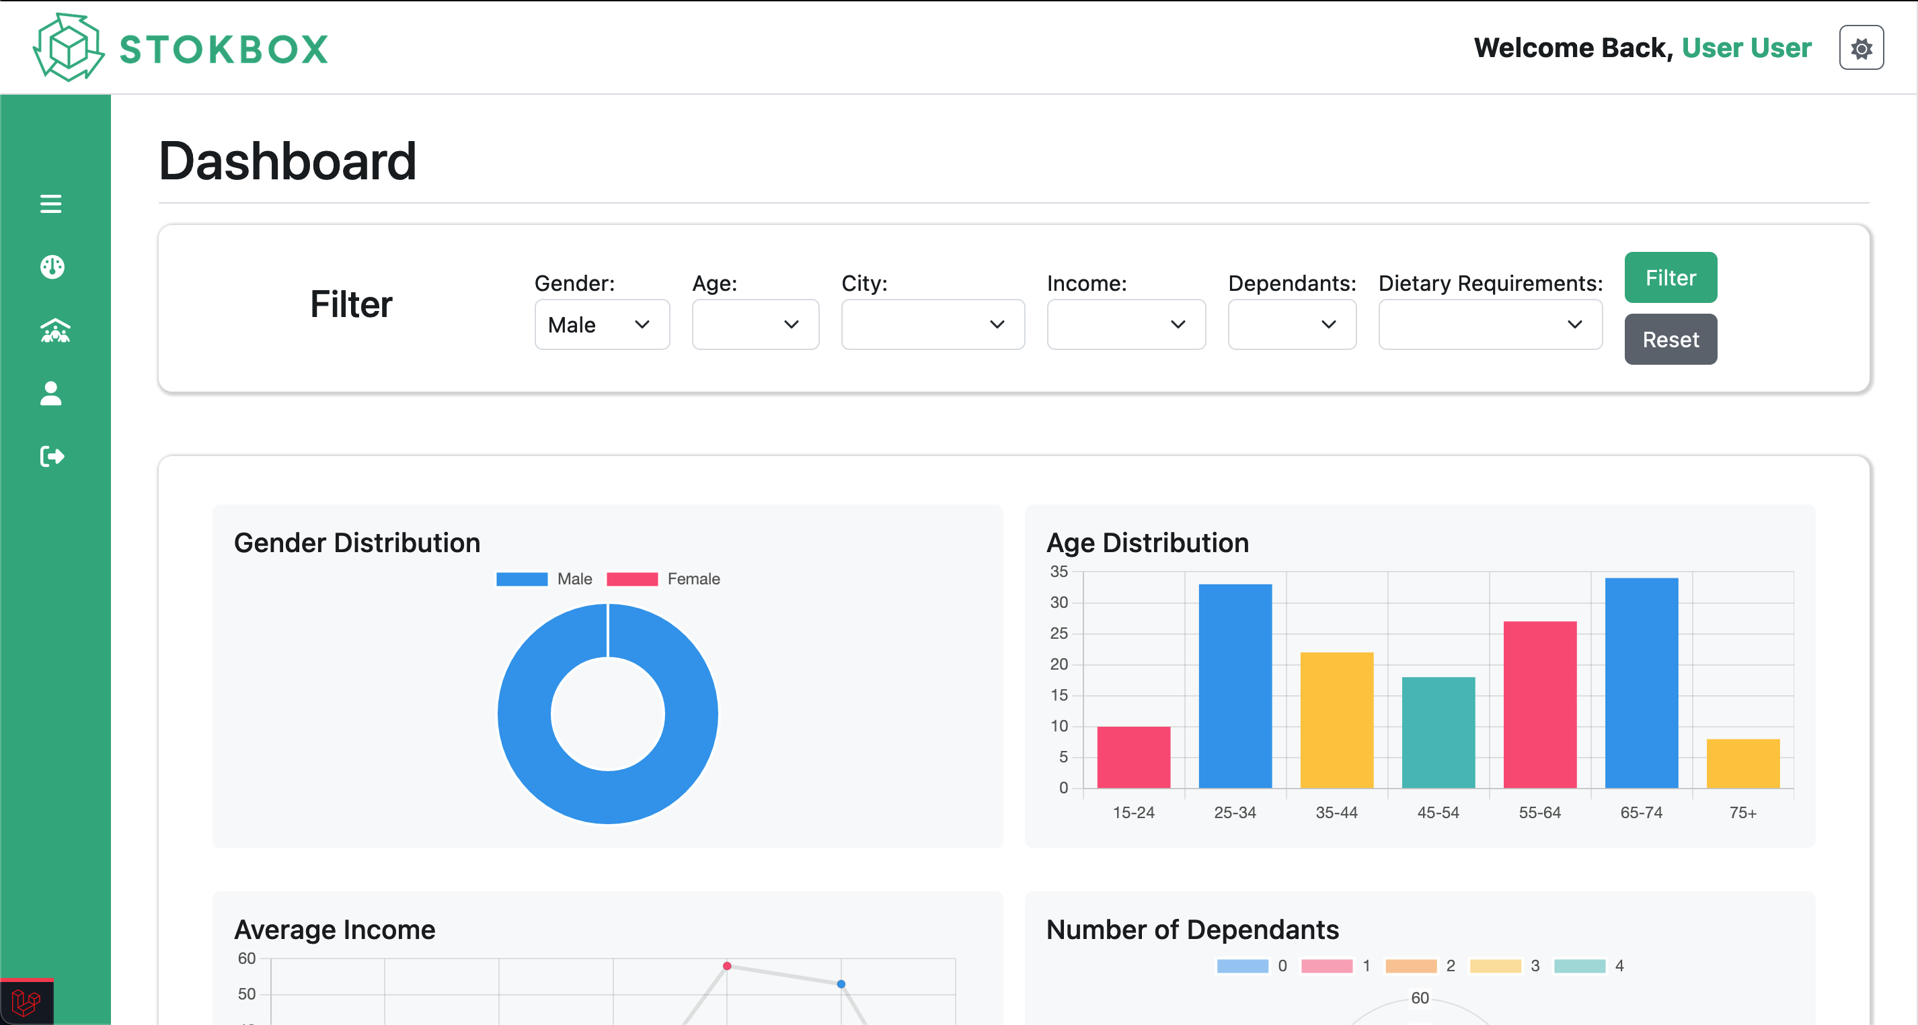
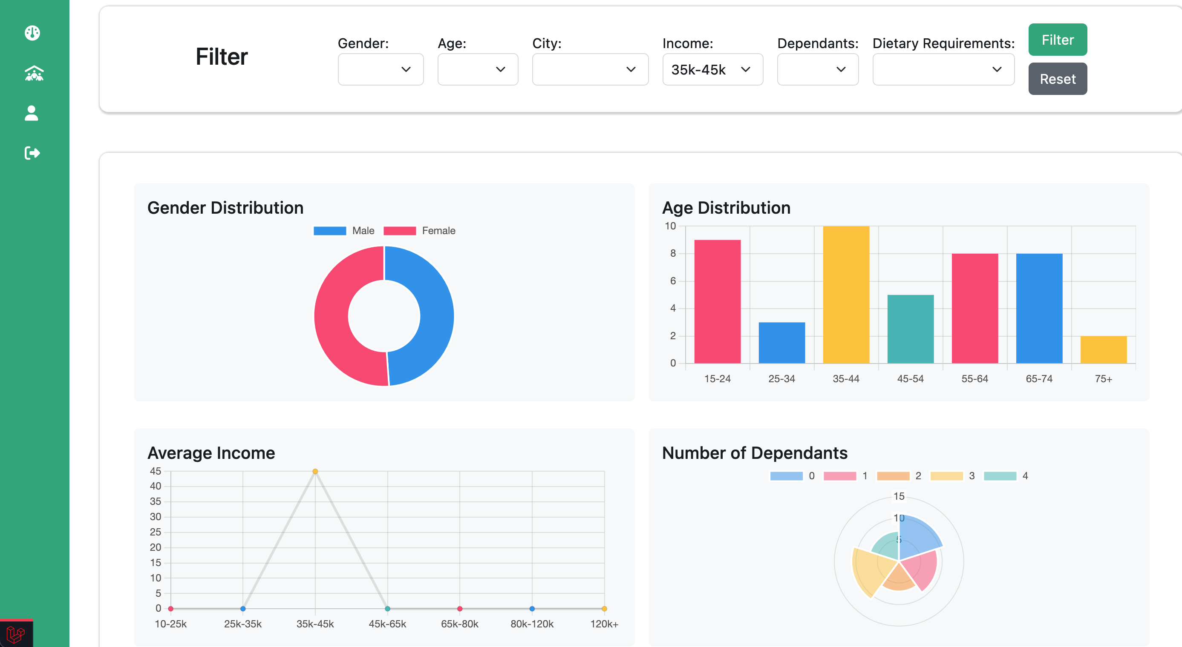
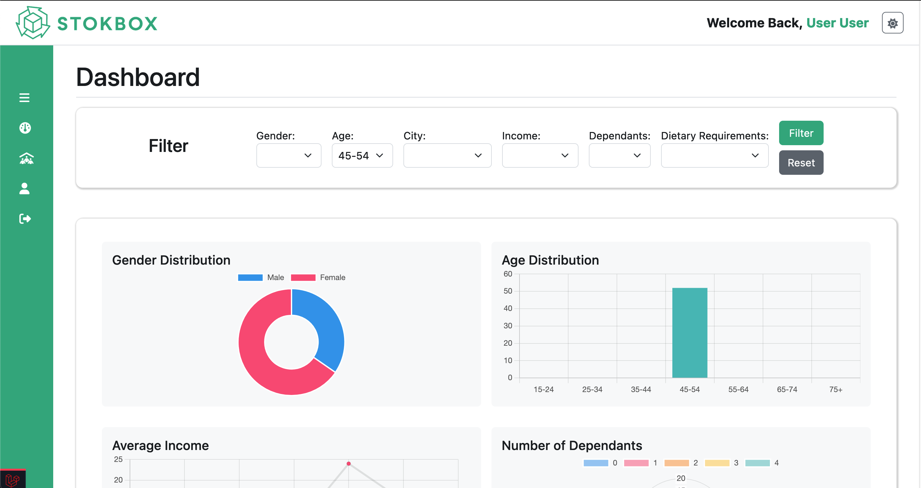
Dashboard Data Filtered
3
A demonstration of key/interesting features
Tharidhu Angodage
Gender
Income
Age

Slide 14
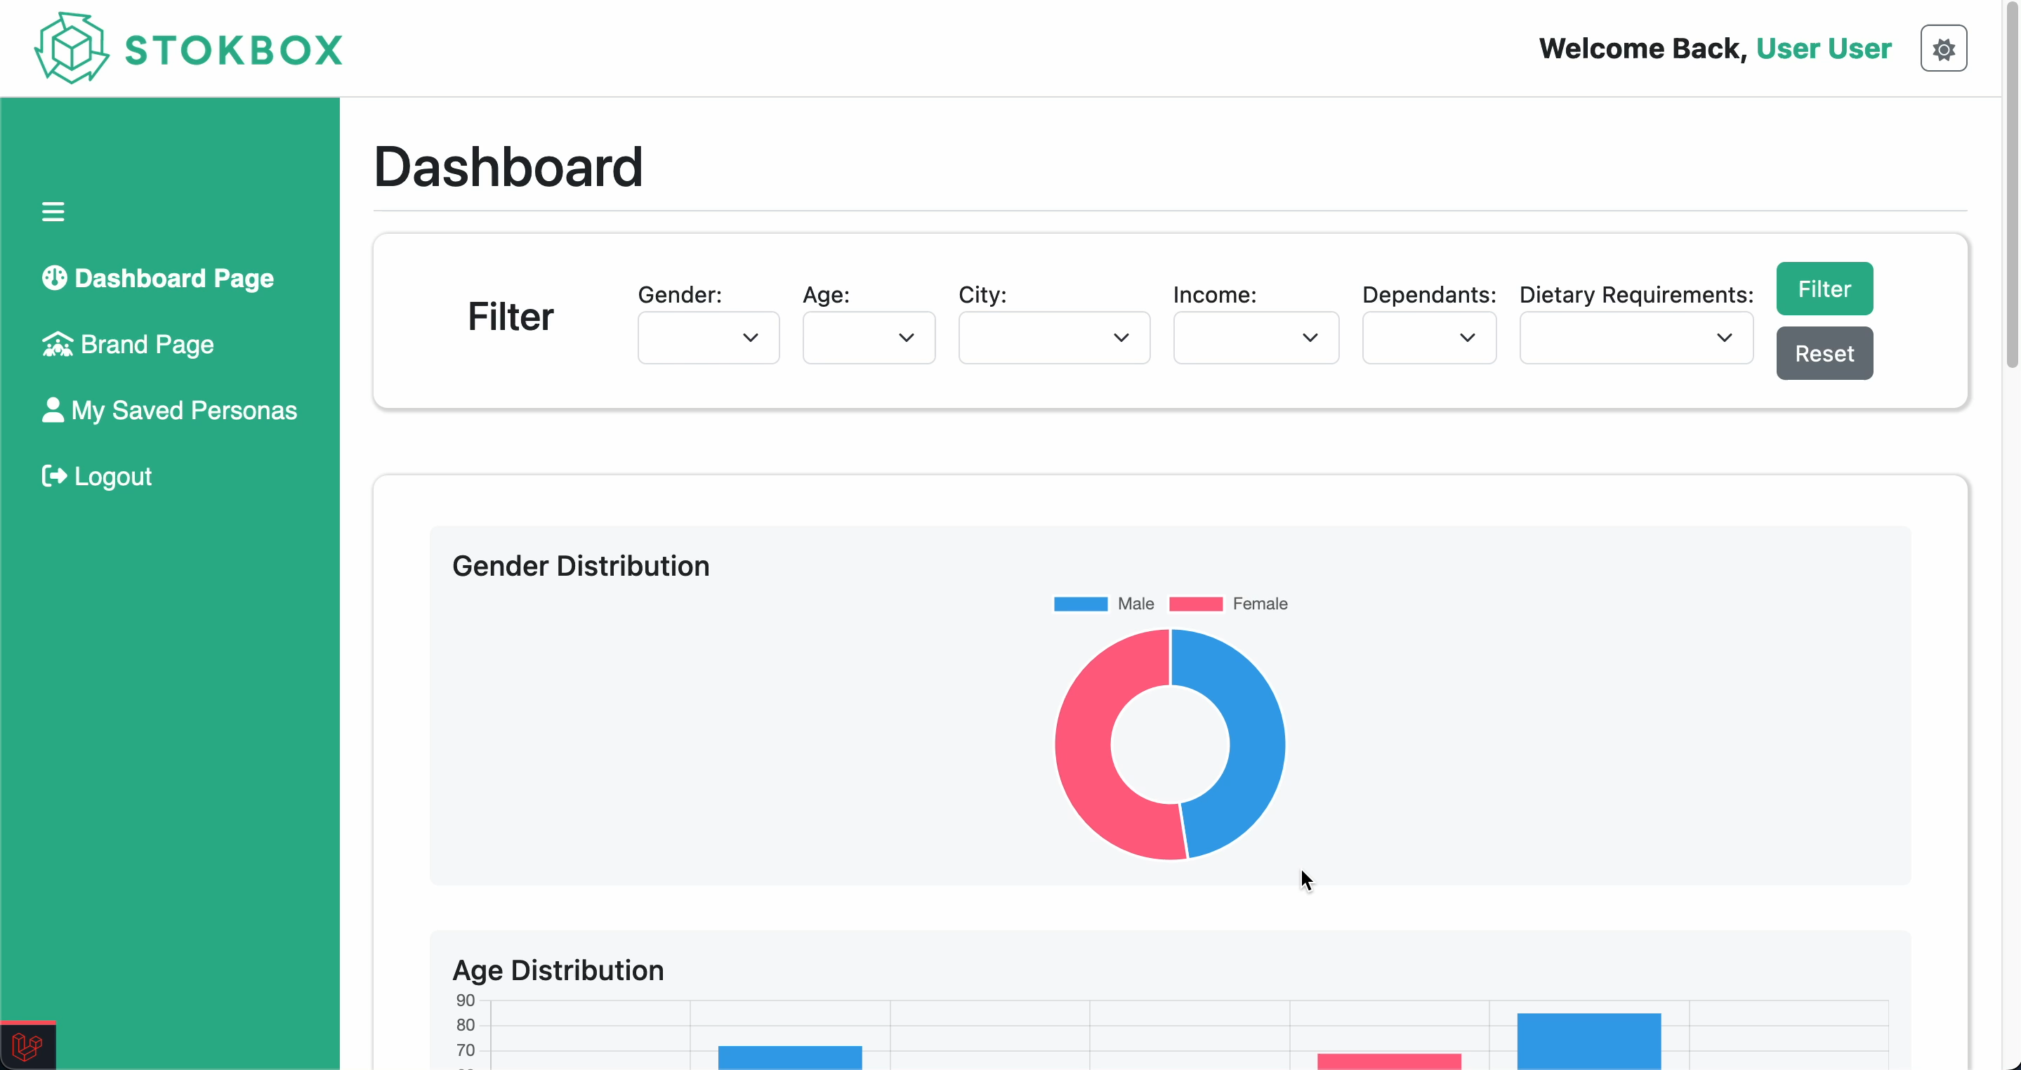
Brand Page Filtering System
3
A demonstration of key/interesting features
Tharidhu Angodage

Slide 15
Determining what pages should be included for the platform
4
Software design decisions
Jack Trafford
We needed to determine the following:
Which user types will be accessing the system (from the client’s brief)
What page hierarchy for each user type
What content should be displayed on each page

Slide 16
Determining what pages should be included for the platform
4
Software design decisions
Jack Trafford
We needed to determine the following:
Which user types will be accessing the system (from the client’s brief)
What page hierarchy for each user type
What content should be displayed on each page
Site Admin | User
Create New Users Manage Users Upload Data View Product Data | Dashboard Brand Page My Saved Personas

Slide 17
Determining what pages should be included for the platform
4
Software design decisions
Jack Trafford
Client requires a platform to demonstrate his vision for the SaaS platform.
We needed to tailor our website’s page hierarchy to match this request.

Slide 18
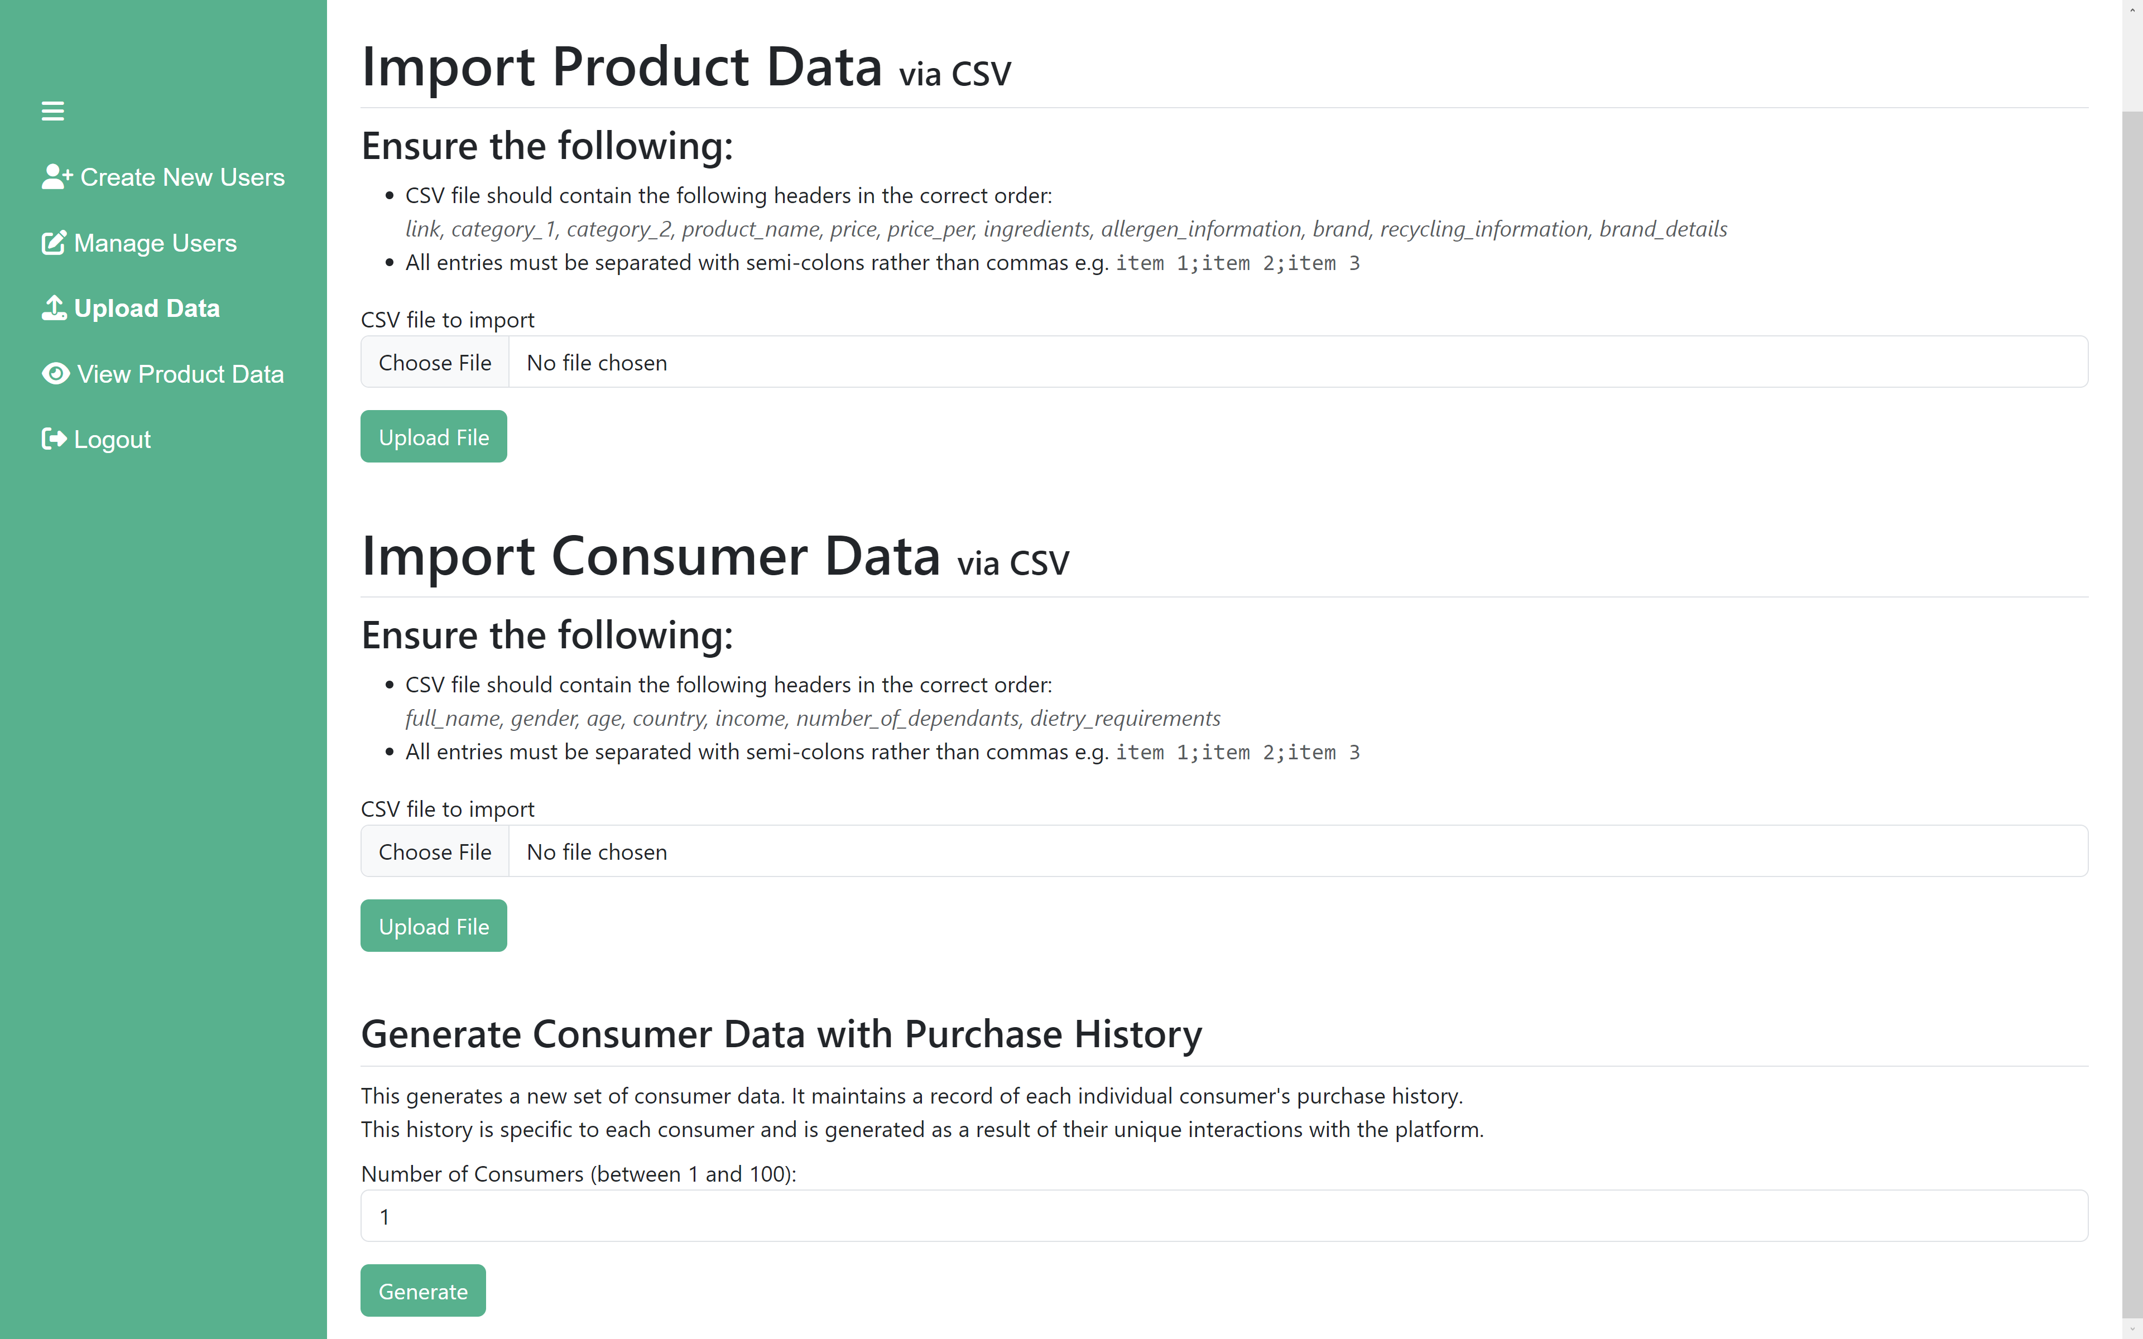
Determining what pages should be included for the platform
4
Software design decisions
Jack Trafford
Client requires a platform to demonstrate his vision for the SaaS platform.
We needed to tailor our website’s page hierarchy to match this request.
Site Admin
Create New Users Manage Users Upload Data View Product Data

Slide 19
Deciding how to implement the personas generation
4
Software design decisions
Jack Trafford
Main part of the platform
How many personas to generate?
How to group personas together?
How to layout each generated persona?

Slide 20
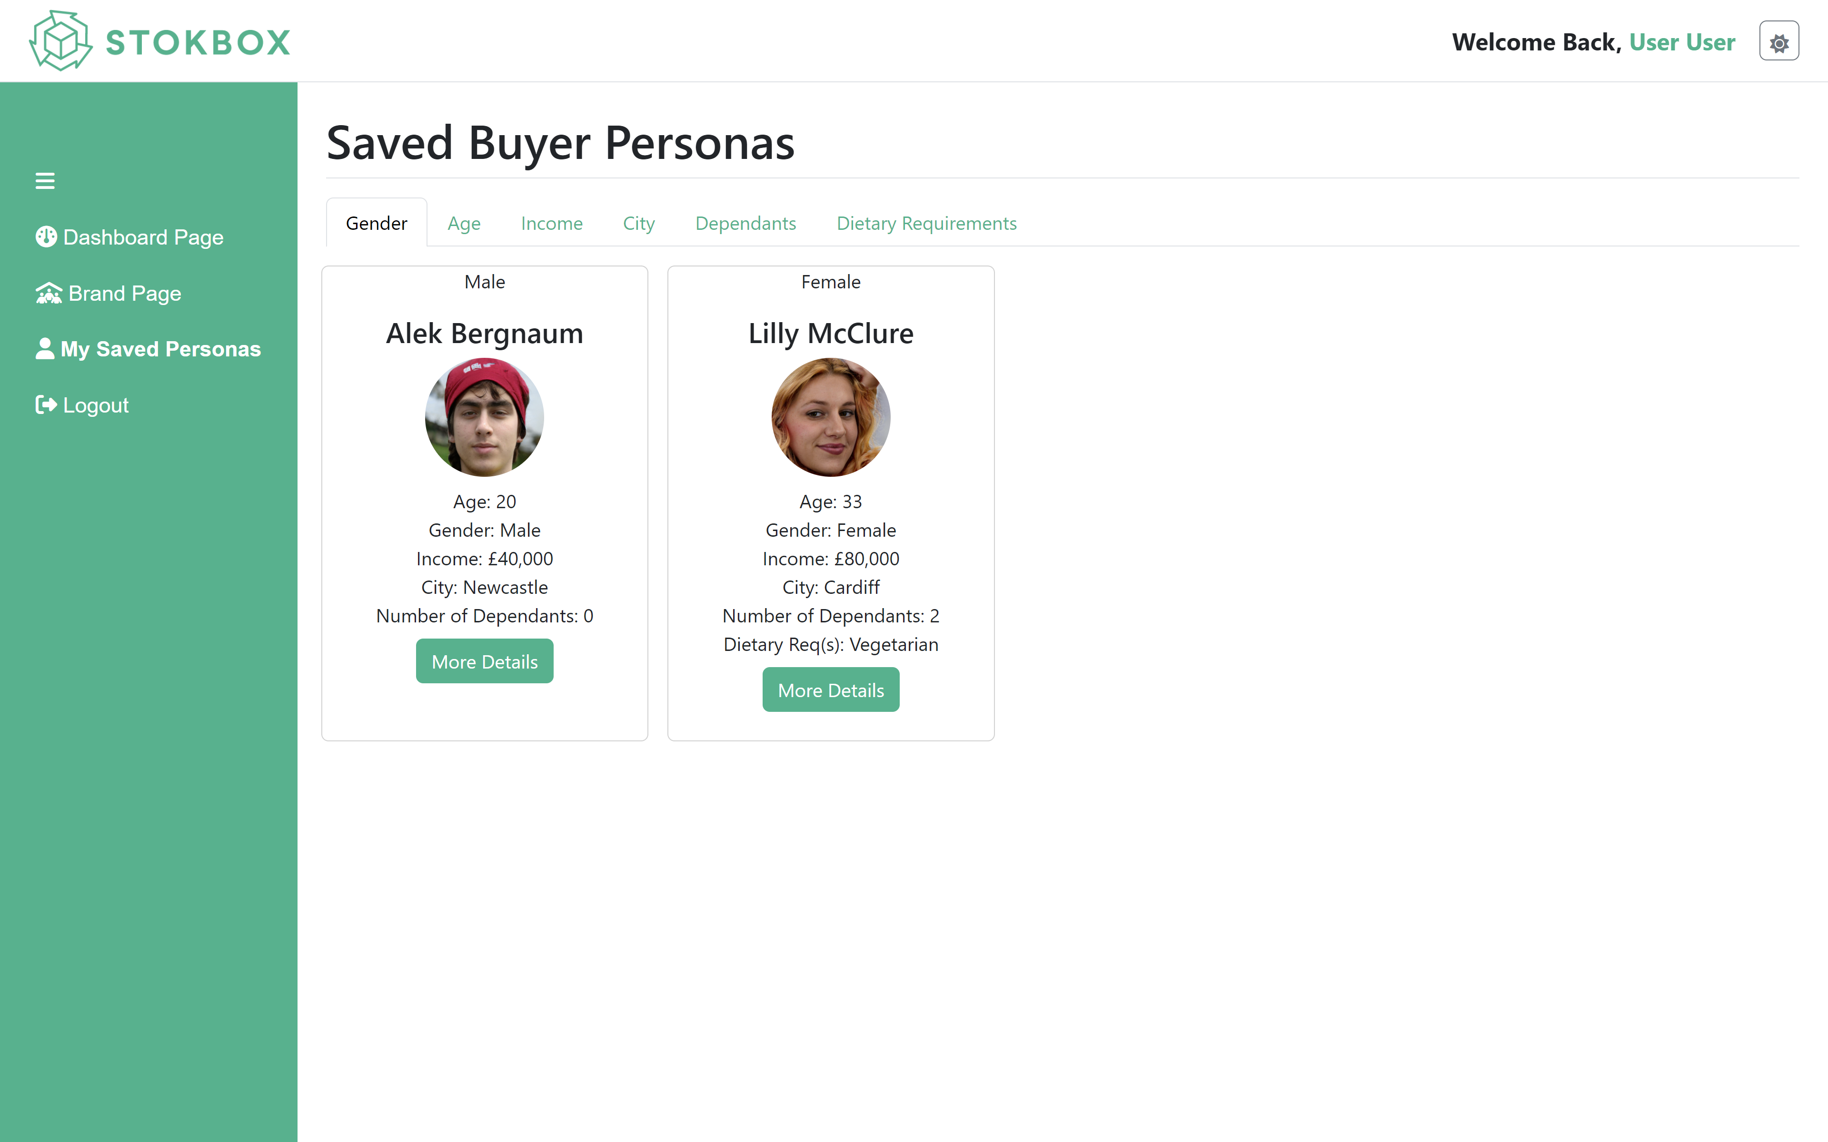
Deciding how to implement the personas generation
4
Software design decisions
Jack Trafford

Slide 21
Time management
5
Something non-technical that you learnt
Darren Wu
Effective time management is essential for the success of any Scrum project.
Scrum implements time-boxing meaning each sprint has a fixed duration (2 weeks)
Effective time management involves many other aspects including planning, prioritization, and monitoring.

Slide 22
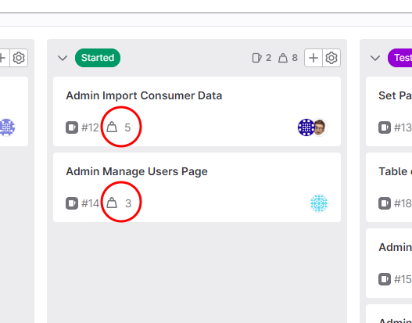
Allocation in time management
5
Something non-technical that you learnt
Darren Wu
Allocating ‘weights’ to each task helped us with allocating members to tasks
Weights show the importance of the task as well as the size of the task
Using the weights, we allocated members accordingly to ensure that tasks were completed in the sprint
Weights also ensure that the critical work is completed first

Slide 23
Group decisions
5
Something non-technical that you learnt
Darren Wu
Understanding everyone’s schedule was important
We made the decision to schedule our meetings every Tuesday at 5pm to avoid schedule conflicts.
The work was allocated the work in these sessions and was also started
It also allowed enough time for work to be completed

Slide 24
Monitoring in time management
5
Something non-technical that you learnt
Darren Wu
Establishing a team environment was important in optimising our time management
Regularly updating the other team members was important for our project
This allowed us to adapt to the current situation and re-allocate if necessary

Slide 25
Conclusion
5
Something non-technical that you learnt
Darren Wu
Overall, effective time management was very beneficial to learn. The benefits of this were very noticeable which included:
Increased productivity
Better decision making
Improved quality of work
Reduced stress

Slide 26

How our group communicated and whether it worked well or not
6
Group Communication
Suraj Cheema
Large group of 8 people
Online communication
WhatsApp
Teams
Email
In person communication
Campus library
Meeting rooms

Slide 27
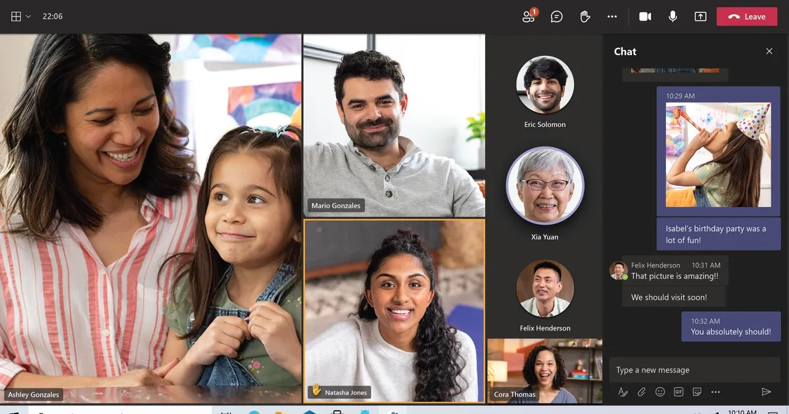
Advantages of online communication
6
Group Communication
Suraj Cheema
More efficient & flexible
Could collaborate from anywhere
Faster development
Easy tools
Screensharing on teams
Source control on GitLab
Easy to manage as SCRUM Master

Slide 28
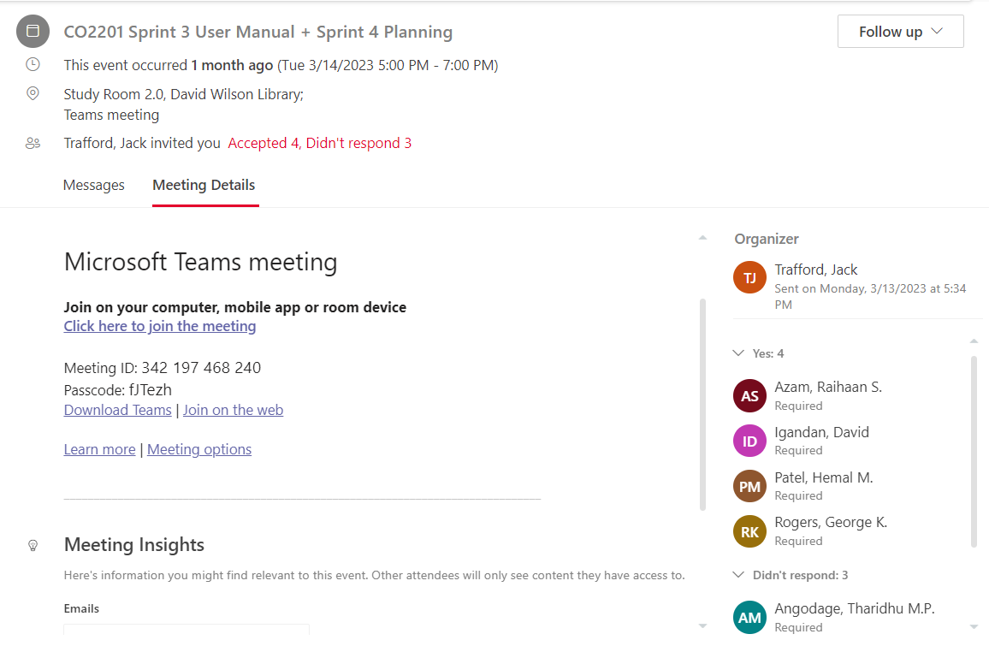
6
Group Communication
Suraj Cheema

Slide 29
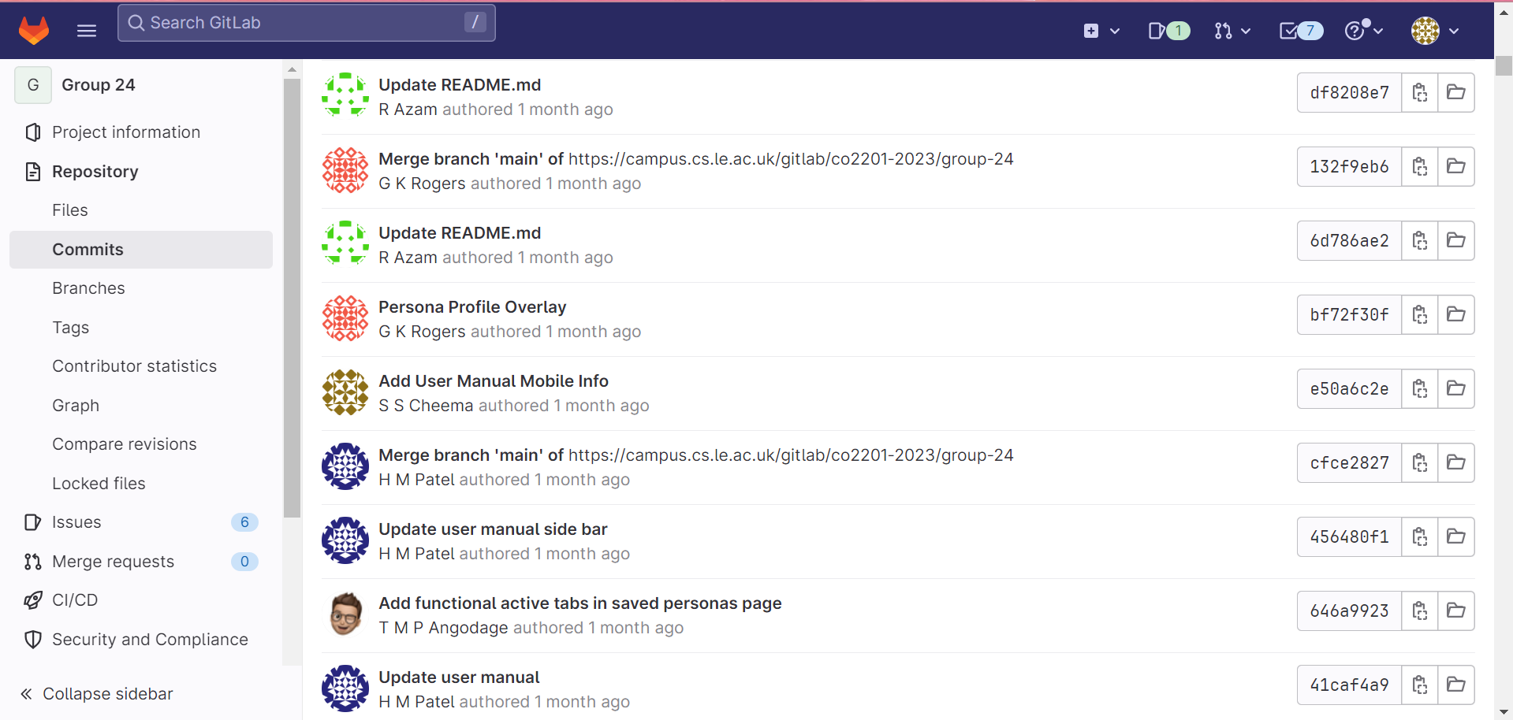
6
Group Communication
Suraj Cheema

Slide 30


Disadvantages of online communication
6
Group Communication
Suraj Cheema
Less clarity
Miscommunication
Distractions
Email & notifications
Less motivating
Technical issues

Slide 31
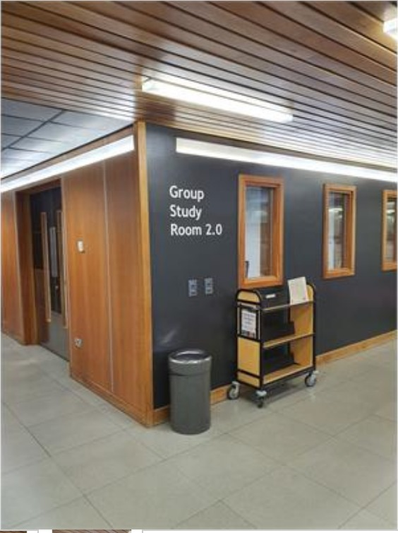
Advantages of in person communication
6
Group Communication
Suraj Cheema
More positive & professional group dynamic
Got to know each other's work style
Higher clarity
Less miscommunication
More supportive
Easy for the SCRUM master to see what was going on

Slide 32

Disadvantages of in person communication
6
Group Communication
Suraj Cheema
Not time efficient
Travelling & booking rooms
Not convenient
Not everyone was available
Not as efficient
Time constraints

Slide 33
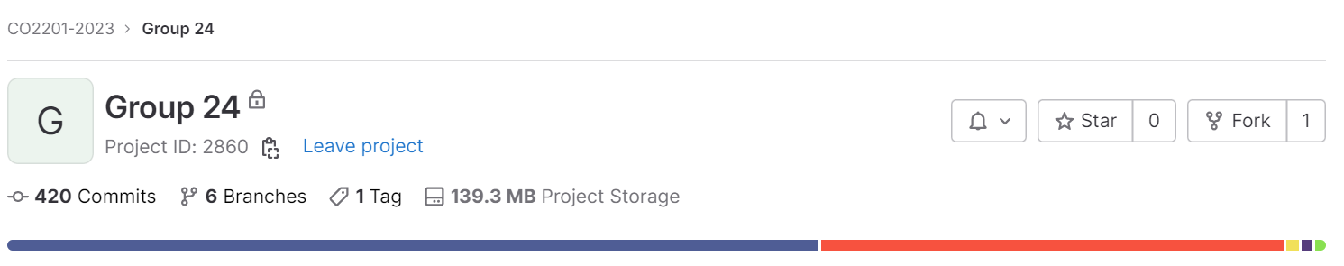
Great Overall!
6
Group Communication
Suraj Cheema
Good group dynamic
Efficient
Still persevered despite shortcomings

Slide 34


Social, Legal or Ethical issues
7
Social/Legal/Ethical Issues
Hemal Patel
Keeping user passwords safe
Preventing hackers from gaining personal information.
Hashing and salting passwords.
Consent to use photos of people for user personas
Using photos with no consent could cause ethical issues.
Photo's might be copyrighted; this causes legal issues.
Economic inequality
People may feel different or left out because of their income.
People may feel degraded.

Slide 35
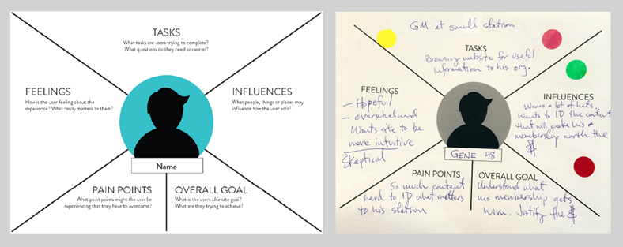
Building on Features
8
Realistic plans to take this project onwards
Raihaan Azam
I’m here to talk about taking the StokBox Analytics project forward.
To further the project, we want to be able provide more accurate algorithms when it comes to generated data for the users. Generated User Personas are a way to obtain insights into the characteristics and behaviours of the target market.
Other features of the project can also be developed to further the project, by analysing the consumer data that StokBox provides.

Slide 36

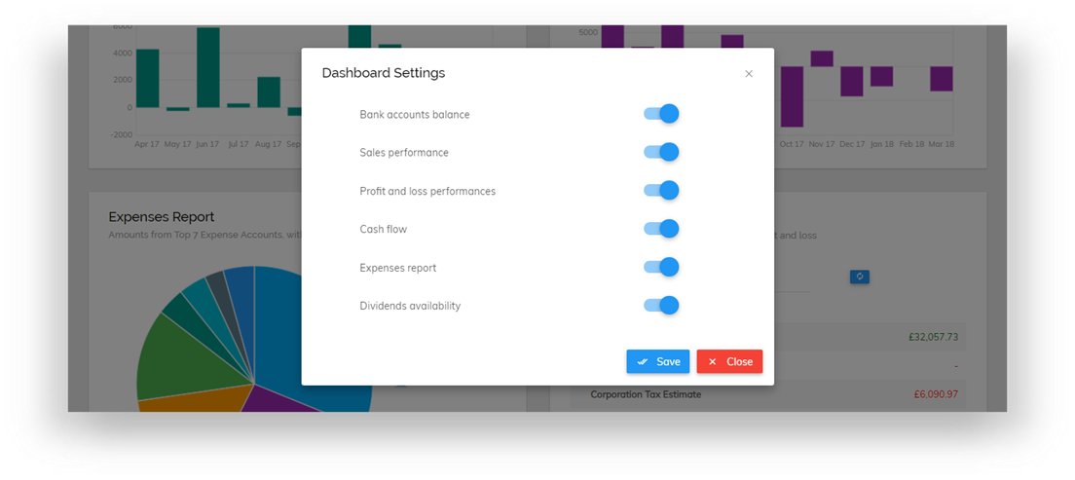
Quality-of-life Updates
8
Realistic plans to take this project onwards
Raihaan Azam
We can also provide some quality-of-life updates for our users, allowing users to customise the dashboard on their account to their own needs is one of this. Doing this, let’s them pick what analytics they want to focus on, saving time having to navigate through the page. This also lets the user get rid of any unnecessary analytics they are not interested in.
Adhering to web accessibility standards is another important quality of life update for the website. This is so that StokBox Analytics becomes inclusive and a better user experience for anyone with disabilities such as hearing or visual impairments.
Example:

Slide 37
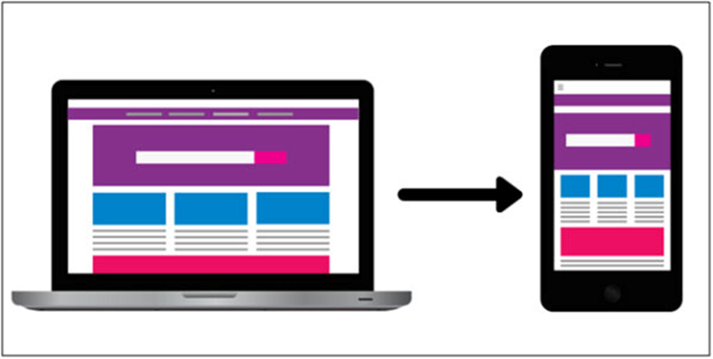
New Features
8
Realistic plans to take this project onwards
Raihaan Azam
A new feature to be added, would be a real time analytics dashboard, meaning that there would be some live data for companies to use to adapt to, if there are changes in their market.
Finally, expanding on the mobile responsiveness of the website, and even fully developing it into a functioning app for users to download.

